Slide 4
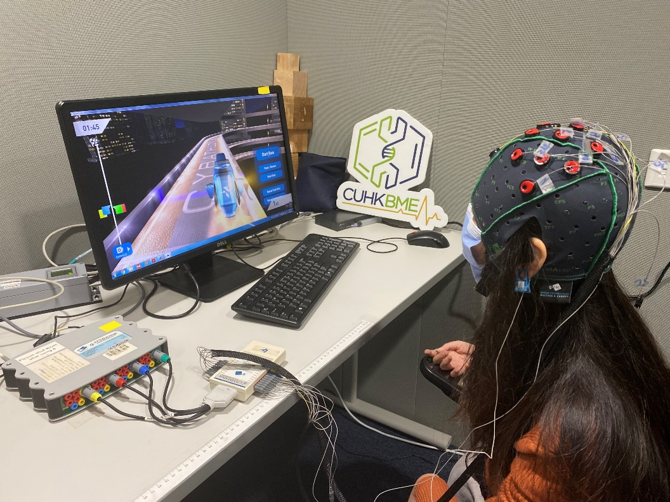
Brain-wave Control Technology for Healthcare or Entertainment 可應用於娛樂或醫療的腦電波控制技術
The Joseph Needham Foundation for Science and Civilisation (Public Lectures on STEM Education)
李約瑟科技與文明基金會STEM教育公開講座
Prof. Raymond Tong 湯啟宇教授
Professor and Chairman
Department of Biomedical Engineering,
The Chinese University of Hong Kong
(香港中文大學 生物醫學工程學學系主任）
27.10.2021

Slide 5
Brain Anatomy Function https://www.youtube.com/watch?v=HVGlfcP3ATI

Slide 7
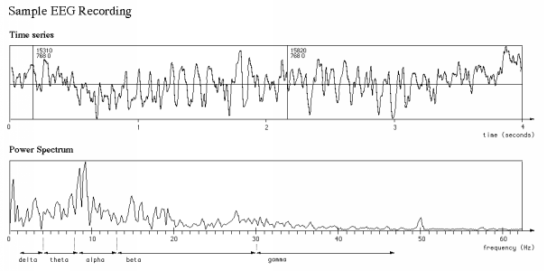
Brainwave 腦電

Slide 8
EEG biofeedback – Cat ears in Japan https://www.youtube.com/watch?v=JblMzmAyLW8

Slide 9
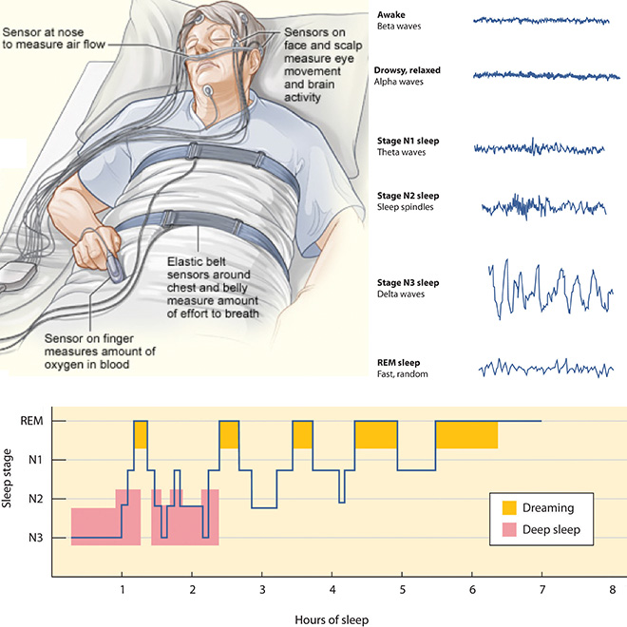

Slide 10
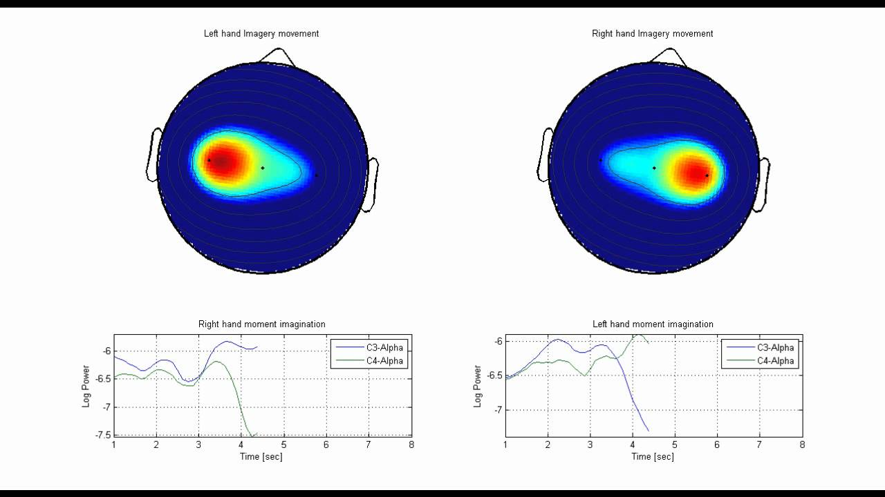

Slide 11
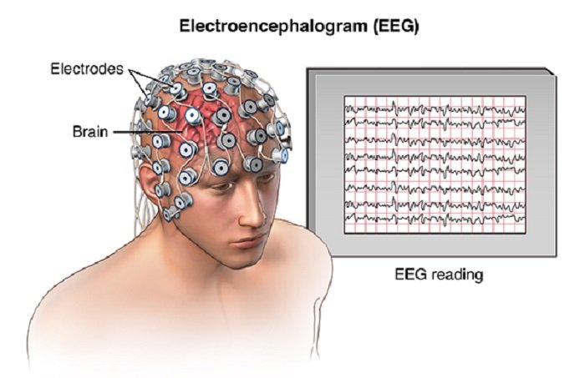
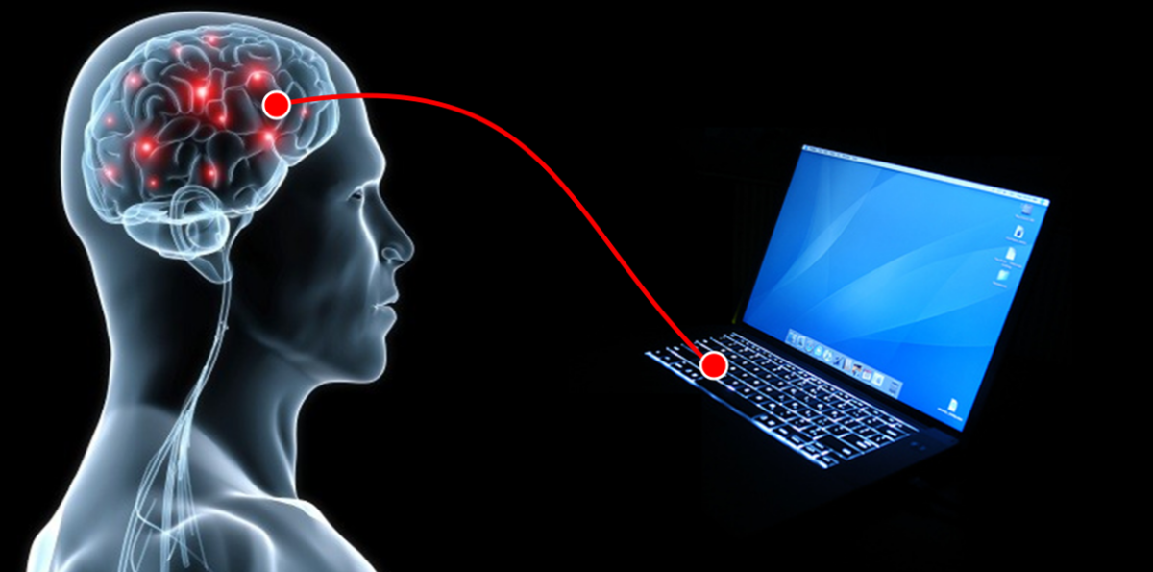
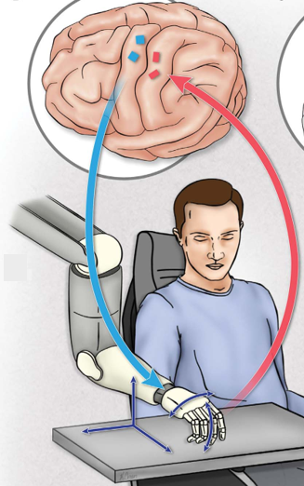
Brain Computer Interface(BCI)
‘意念控制’
https://science.sciencemag.org/content/372/6544/831/tab-pdf, https://autism360.com/news/are-eeg-signals-likely-to-predict-autism/, https://nirx.net/blog-content/2019/10/7/fnirs-based-bcis-can-we-catch-up

Slide 12
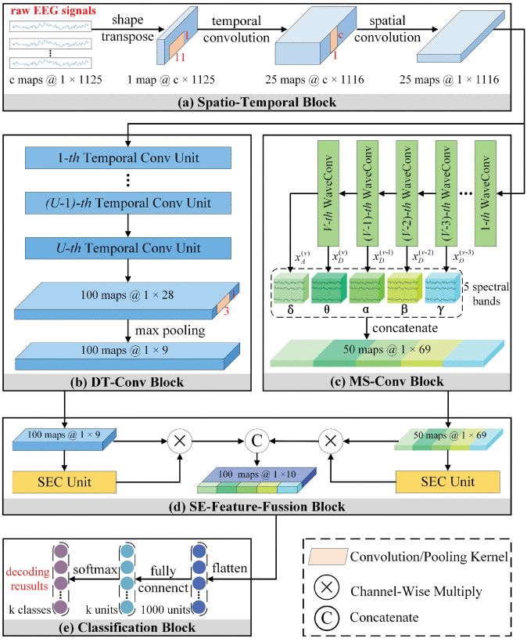
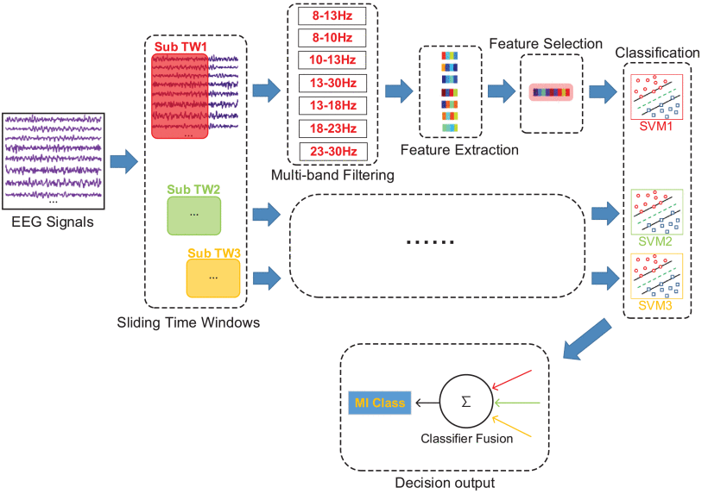
人工智能助力信號分析
AI analysis
Learning Common Time-Frequency-Spatial Patterns for Motor Imagery Classification,
A Temporal-Spectral-Based Squeeze-and-Excitation Feature Fusion Network for Motor Imagery EEG Decoding

Slide 13
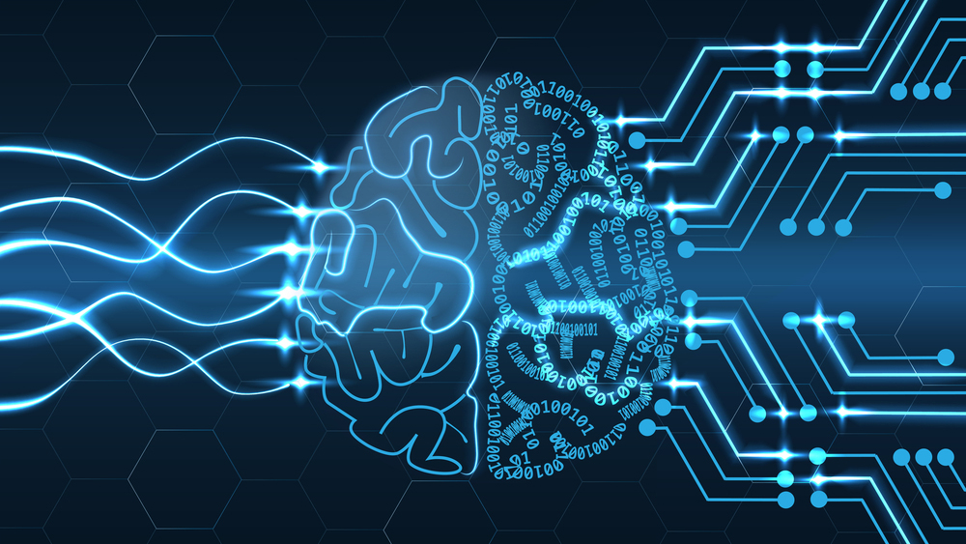
Faster更快
More Accurate更準確
More Reliable更穩定
Learning Common Time-Frequency-Spatial Patterns for Motor Imagery Classification,
A Temporal-Spectral-Based Squeeze-and-Excitation Feature Fusion Network for Motor Imagery EEG Decodinghttps://www.bschool.cuhk.edu.hk/chi/china-business-knowledge/artificial-intelligence-wont-solve-everything-tc/

Slide 14
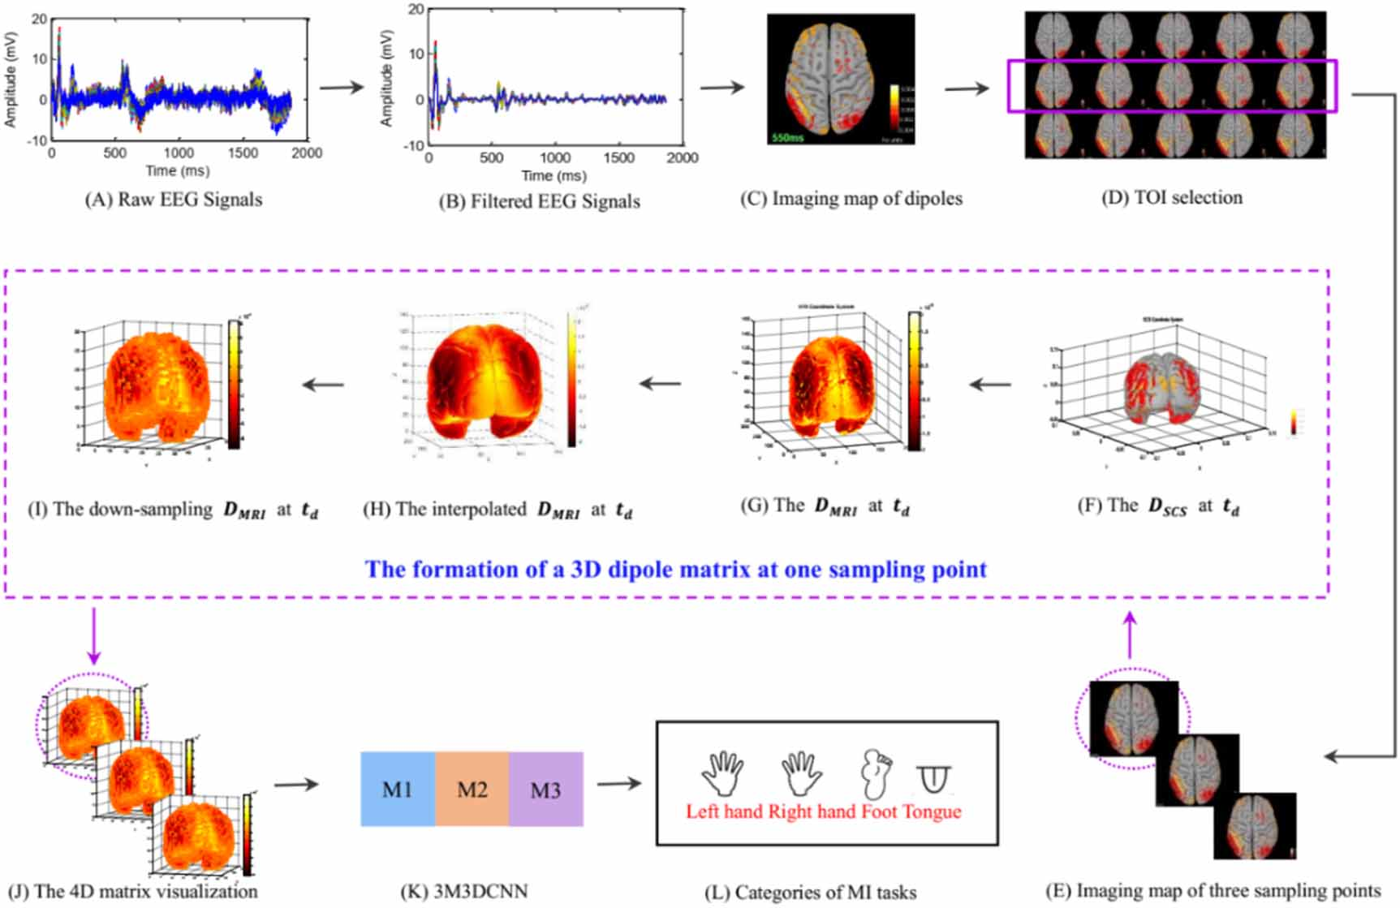
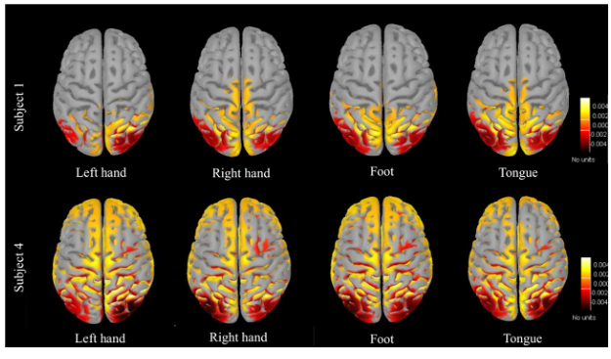
Neuroimaging
神經影像技術揭秘人腦運作
Learning Common Time-Frequency-Spatial Patterns for Motor Imagery Classification,
A Temporal-Spectral-Based Squeeze-and-Excitation Feature Fusion Network for Motor Imagery EEG Decoding

Slide 15
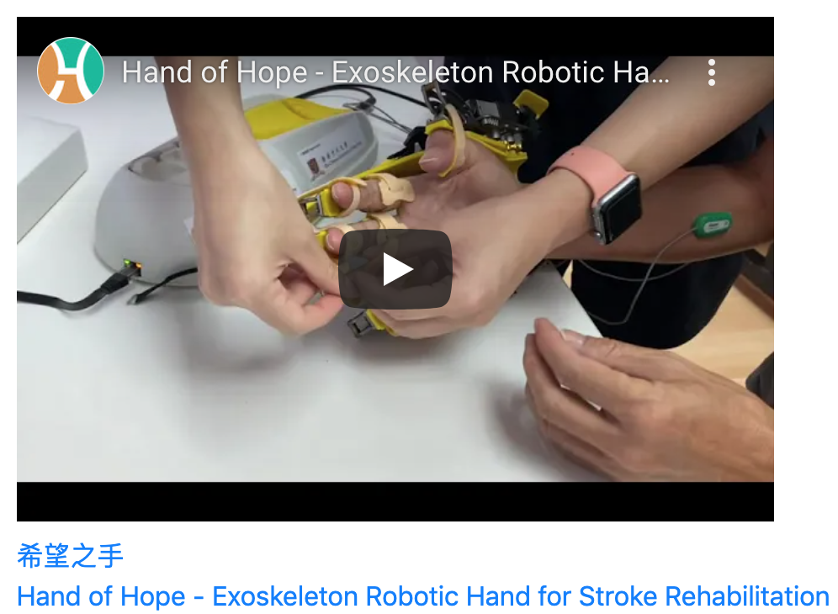
Application - for Healthcare
https://youtu.be/D5fJOFzw3mY

Slide 16
Hand of Hope 希望之手

Slide 17
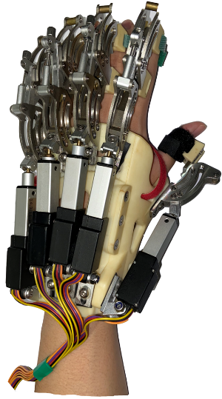
Brainwave for Stroke Rehabilitation
Motor Improvement !
Yuan, Kai*, Cheng Chen*, Xin Wang, Winnie Chiu-wing Chu, and Raymond Kai-yu Tong. ”BCI training effects on chronic stroke correlate with functional reorganization in motor-related regions: A concurrent EEG and fMRI study.” Brain Sciences 11, no. 1 (2021): 56.
Cheng, Chen*, Kai Yuan*, Xin Wang, Ahsan Khan, Winnie Chiu-wing Chu, and Raymond Kai-yu Tong. ”Neural Correlates of Motor Recovery after Robot-Assisted Training in Chronic Stroke: A Multimodal Neuroimaging Study.” Neural Plasticity 2021 (2021).

Slide 18
Application - for Entertainment

Slide 19
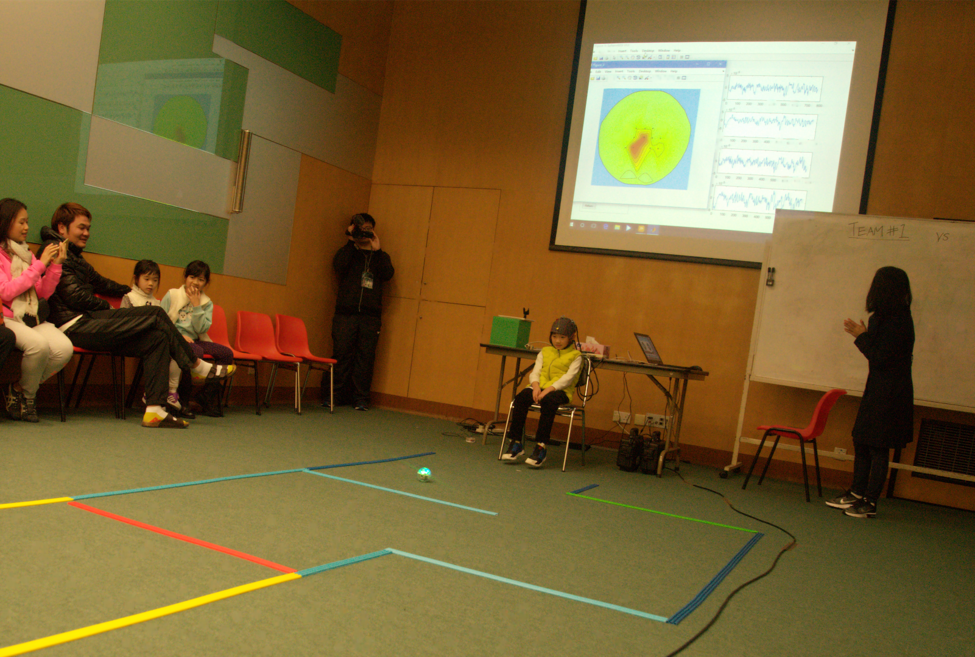
Application - for Entertainment

Slide 20
Demo

Slide 21
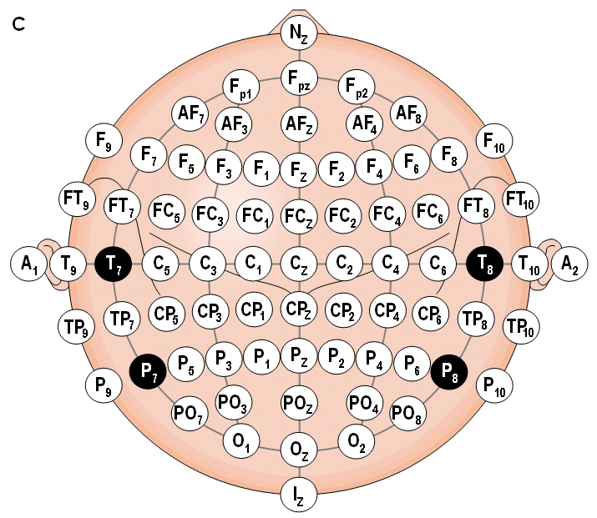
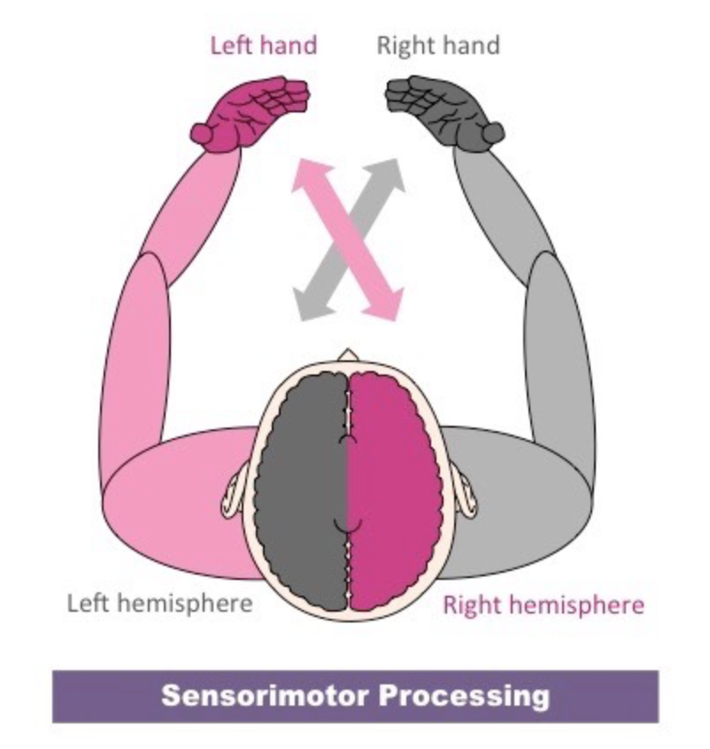
Location and nomenclature of the intermediate 10% electrodes, as standardized by the American Electroencephalographic Society. (Redrawn from Sharbrough, 1991.).

Slide 22
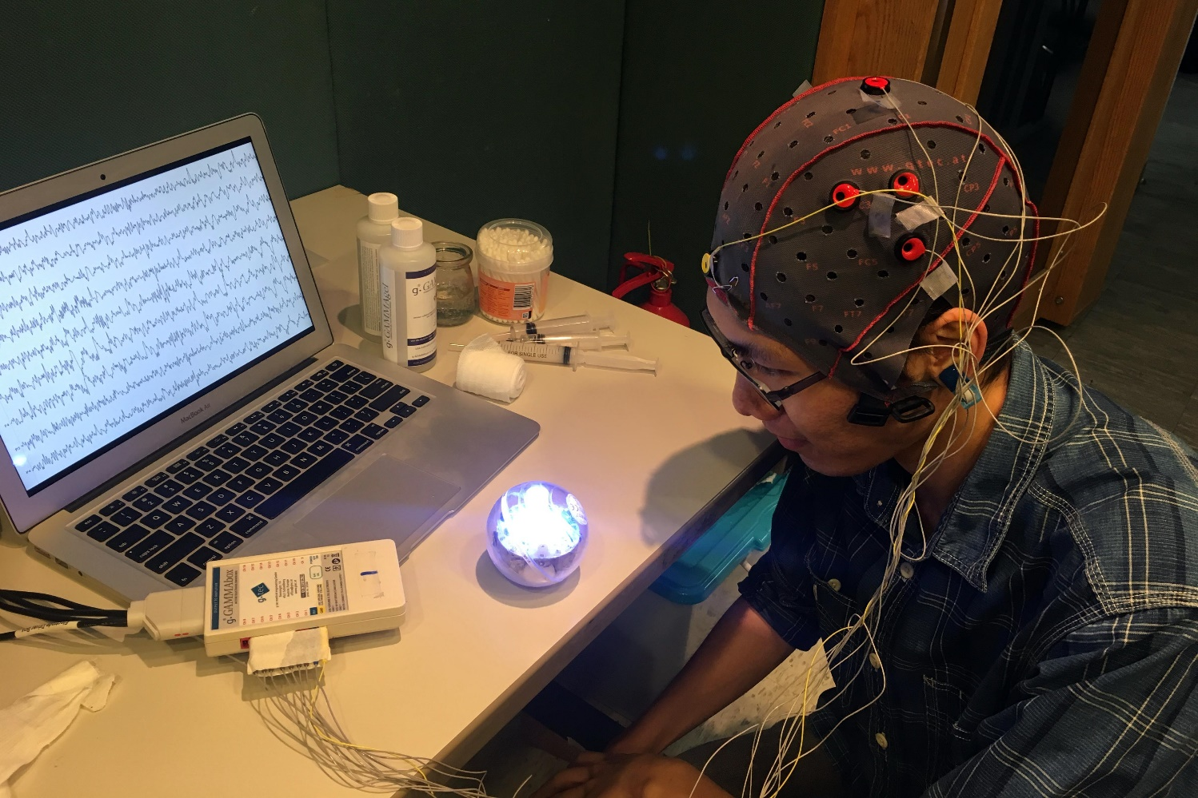
computer
electrodes
amplifiers

Slide 23
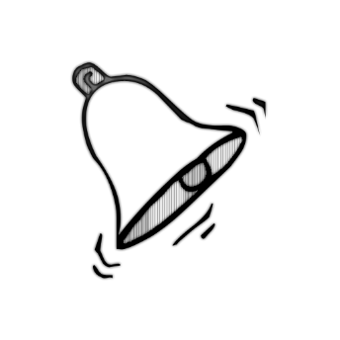
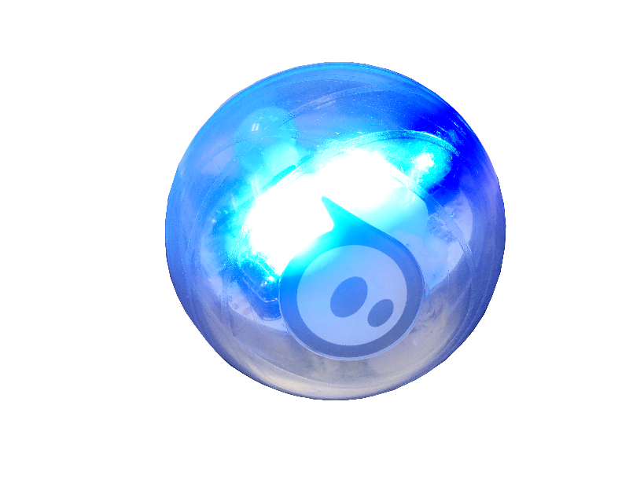
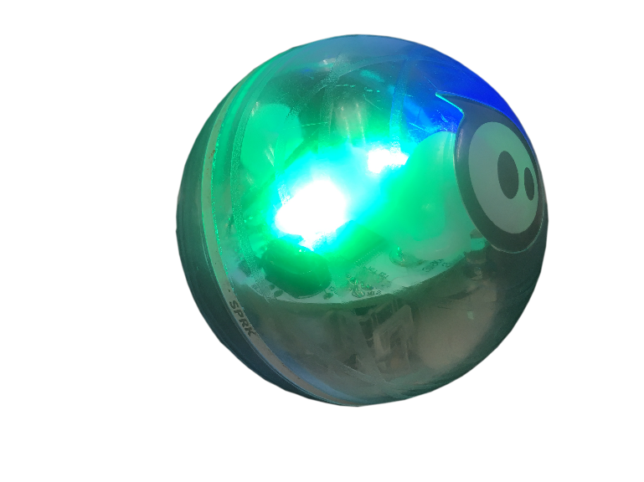
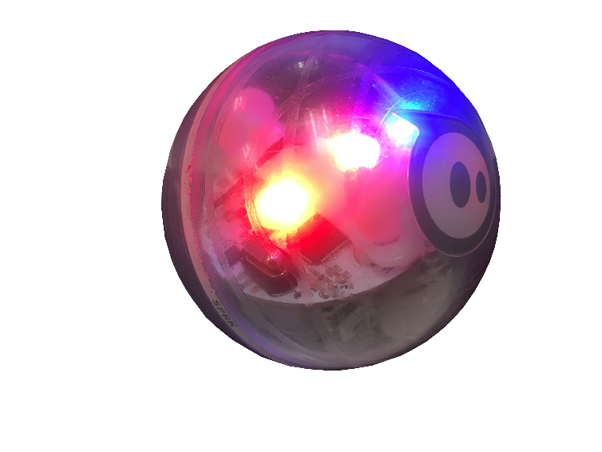
‘滴’聲過後，集中註意力思考方向
恭喜你，思考正確，小球朝正確方向滾動,準備思考下一輪.
很抱歉，思考錯誤，小球會先向你所想方向滾動，然後會滾到原位，準備重新開始思考這一輪。

Slide 24
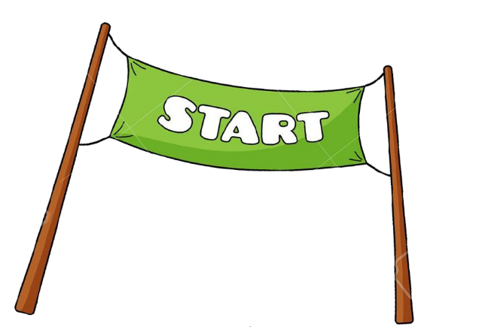

Slide 25
Start

